Slide 1
Electrical sensors
Group 20

Slide 2

THRIVE AFRICA GROUP PROECT
GROUP TWENTY (20)
Pamela Dzidzor
Musah Adomah
Enoch Jackson Nartey
Aloku Christopher Abugatwin
Sunu Oswald Kwesi
Bismark Adjei
Precious Acquah
Gladys Owusuwaa Boamah
Yakubu abubakari
Emmanuel Kobina Tetteh
Asuaboah Patrick
Nana Afrah Edjeafene
Juliana Fobi
Ebenezer Cobbinah

Slide 3

Content
1️⃣ Title Slide 2️⃣ Agenda 3️⃣ Problem Statement 4️⃣ Dataset Overview & Methodology 5️⃣ Question Driving This Analysis 6️⃣ KPI Dashboard 7️⃣ Insights 8️⃣ Recommendations 9️⃣ Conclusion

Slide 4
The company faces key challenges around how work hours, salaries, and remote work affect productivity and employee satisfaction especially with unexpected salary imbalances and inconsistent performance across roles and locations.
Problem Statement
In today’s fast-paced and often hybrid workspaces, what helps people do their best work isn’t always obvious. While leaders tend to focus on performance and results, factors like stress, flexibility, and even your job role can quietly shape how productive you feel. Through this analysis of 10,000 employees, we dig deeper to understand what truly drives productivity, and where things might be getting in the way.

Slide 5
About the Dataset & methodology
Dataset was download from Kaggle.com and is designed for advanced HR analytics, machine learning, and organizational behaviour studies The dataset includes demographic details like age and gender, work conditions such as weekly hours, overtime, remote days, flexible policy, plus well-being metrics like stress level and work-life balance and of course, the productivity score
Data cleaning and visualization was done using both Ms Excel and Power BI
Our steps were:
Cleaning, Preparing and transforming the raw data in excel and power BI respectively.
Creating key KPIs and charts to spot patterns.
3. Using the dashboard to draw conclusions and recommendations.

Slide 6
Question Driving This Analysis
How many projects were completed in total
How do various geographical factors (Locations) influence employee productivity
How do organizational policies influence employee productivity (Remote days)
How does Work life balance, remote days and Productivity relate
Is there a link between employee age groups and their productivity levels? (Age & Productivity)
Salary distribution between the various Job roles
Does salary distribution vary based on location
How do salaries change with employee tenure? (Tenure & Salary)
Let’s check out the Dashboard in the next Slide

Slide 7
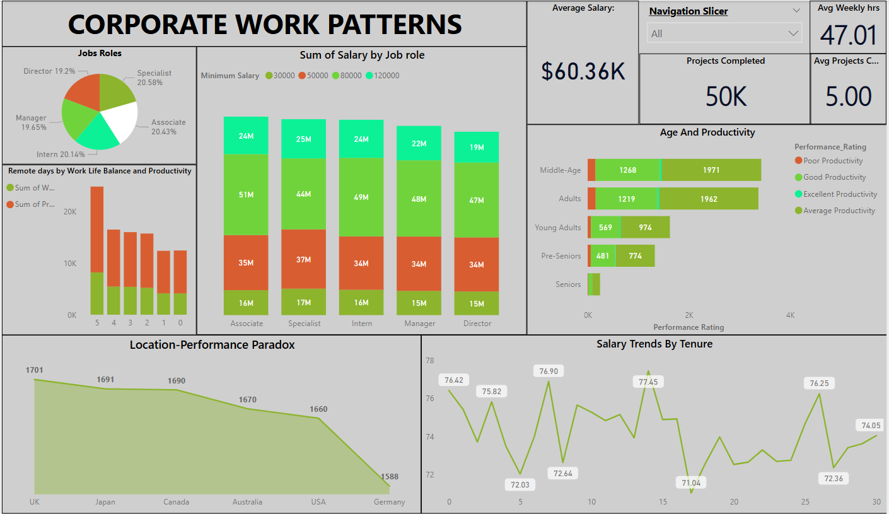

Slide 8
What does the Data reveal?
The average weekly hours of workers is 47.32. Employees are likely overworking, possibly under pressure to meet targets.
Based on locations, people in London, UK tend to have highest productivity ratings with the least being Berlin, Germany
Those with higher remote days have high work life balance
Employees working 5 remote days have higher total productivity compared to those with fewer or zero remote days.
Age Distribution in Productivity: Middle-aged adults and adults make up the largest groups across all productivity levels. Seniors show very limited performance contribution, possibly due to retirement or physical limitations
Salary fluctuates over tenure. No consistent upward trend, which is odd.
The number of Workers in the various Job roles are almost the same throughout but surprisingly, the total minimum salary range for associates and interns are higher than that of Managers and Directors.
Implication: This indicates a potential imbalance in the salary structure.
Tokyo, Japan seems to distribute Salaries properly with the directors earning more followed by Managers but New York, USA does the vice versa

Slide 9
Actionable recommendations
The current imbalance suggests entry-level staff collectively earn more than leadership, potentially demotivating key decision-makers. Reassess the salary structure to ensure Managers and Directors earn more than Interns and Associates
Globally, 40 hours/week is the usual full-time standard. Keep average hours below 45 hours/week, unless employees are highly engaged and well-compensated for overtime.
Encourage flexible or remote work policies because data shows employees with more remote days are significantly more productive and balanced.
Leverage the strengths of middle-aged and adult workers by placing them in key roles and mentorship programs, since they show the highest productivity ratings. Or Create training programs based on age group productivity trends where middle agers train the other age groups.

Slide 10
Actionable recommendations
Investigate low productivity in Germany by assessing management styles, infrastructure, and employee satisfaction to identify and fix underlying issues. Or investigate best practices in London and try to replicate them in Berlin
Establish a consistent and motivating salary progression path across tenure to prevent dips that can demotivate employees and increase turnover risk.
Optimize project distribution across job roles to avoid underutilization and ensure maximum output from the available workforce.
Conduct regular salary and performance audits to maintain fairness, close pay gaps, and align rewards with actual contributions

Slide 11
This analysis has revealed critical insights into how work patterns, job roles, compensation, and workplace policies are influencing employee performance and well-being across the organization. key findings such as the positive impact of remote work, workload imbalances, and salary misalignments highlight opportunities for both optimization and innovation. By addressing these gaps especially in salary structure and workload management, the company can not only improve productivity but also strengthen leadership retention, employee satisfaction, and long-term organizational efficiency
CONCLUSION

Slide 12

THANK YOU!
With the right adjustments, we can work smarter, lead stronger, and grow faster.

